Slide 1
Churn Analysis
Group 7
Kaike Vieira
Azizbek Makhmudov
Kateryna Padopryhora
Sonal Rathod
Avani Panchal

Slide 2
Context of Project
In today’s competitive business environment, customer retention is critical for maintaining profitability. Understanding why customers churn (leave) is essential for businesses to grow and maintain their customer base.
This project aims to explore patterns of customer churn, identify the key factor, and provide recommendations for reducing churn.
Focusing on customer churn helps improve overall marketing efficiency. This analysis dives into various customer segments, their behaviors, and how these impact churn rates.

Slide 3
Objectives
The primary objective of this analysis is to identify customer groups most likely to churn and determine the factors contributing to their churn. This includes:
Segmenting customers based on geography, device usage, gender and other attributes to find churn patterns.
Analyzing churn rates in different customer groups to see where to focus efforts
Providing recommendations to help the business reduce churn

Slide 4

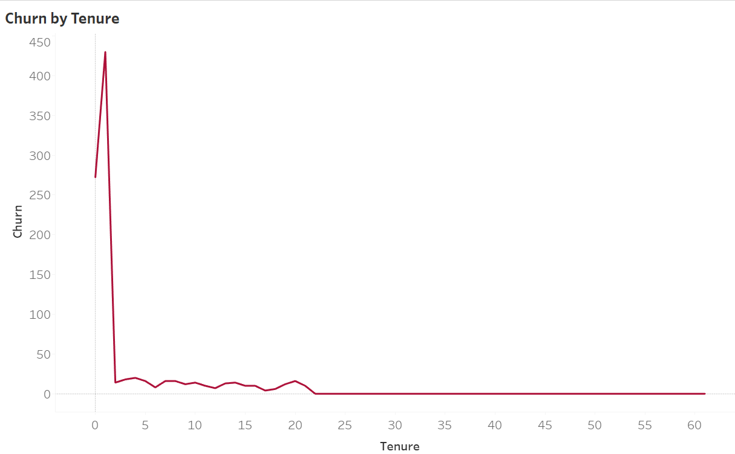
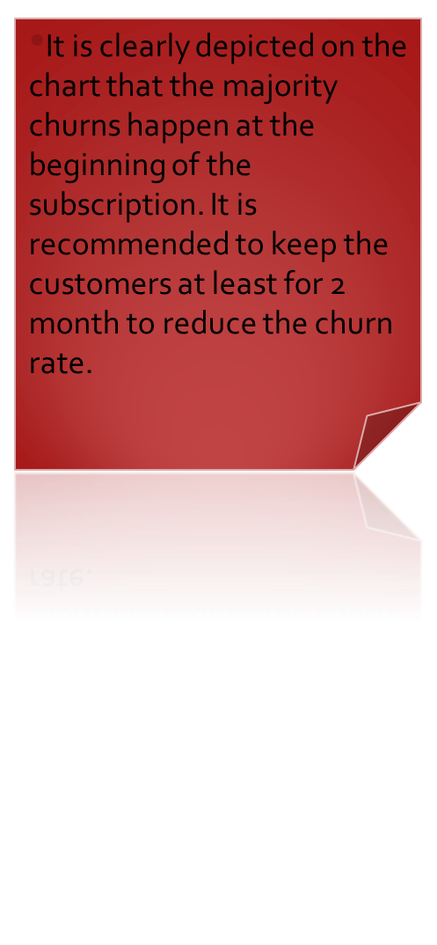

Slide 5
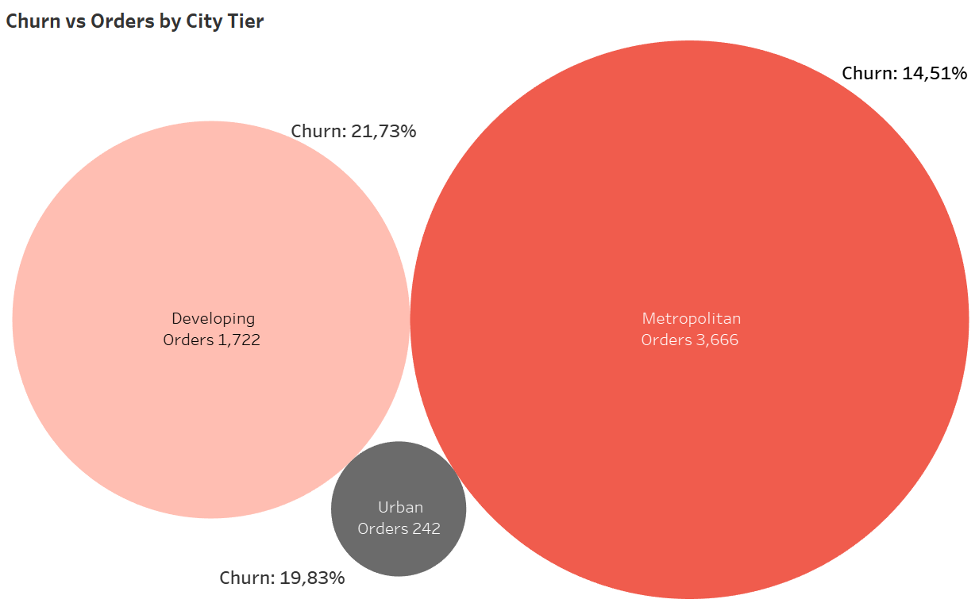
People in big cities are tend to be more loyal, therefore It would be wise to focus on more citizens while the customers from Urban and Developing areas need to be analyzed more to improve the churn rate.

Slide 6

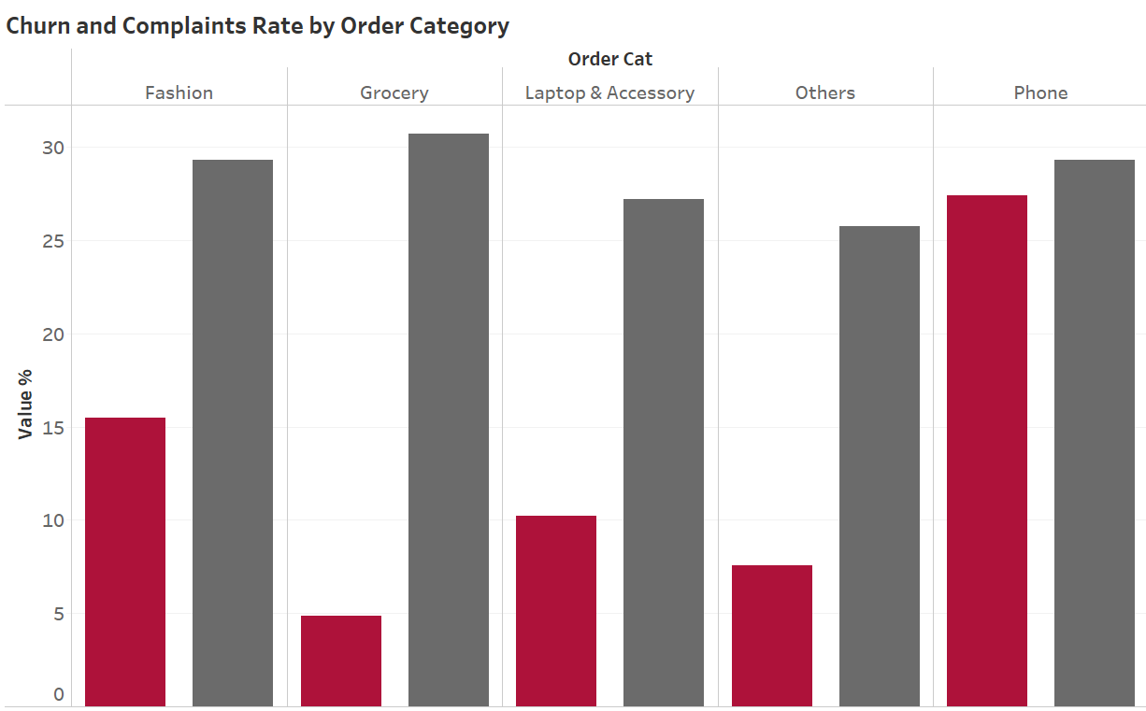
It is highly recommended to improve the Phone market as it shows the highest rate of churn , even though Grocery has biggest number of complaints, its customers are more likely to be loyal than any other category in the chart.

Slide 7

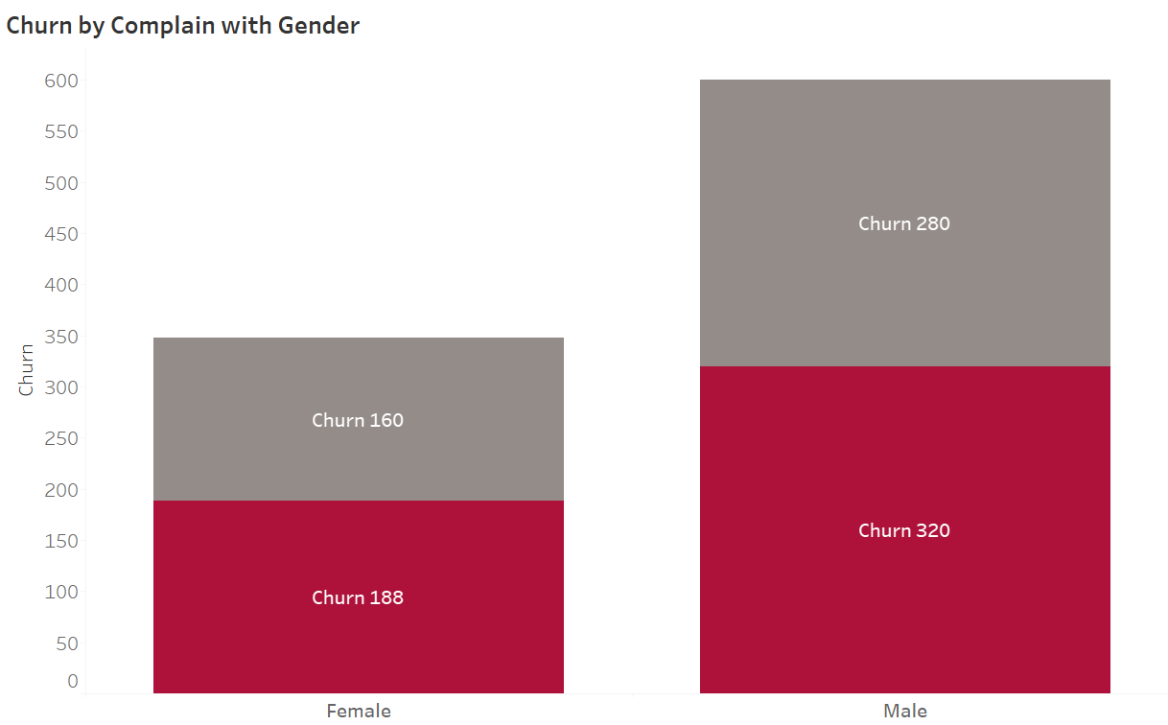
In percentage wise, Women typically churn slightly more than men, 54% and 53.33% in turn. However, this difference is not significant which lets us to focus on both genders equally.

Slide 8
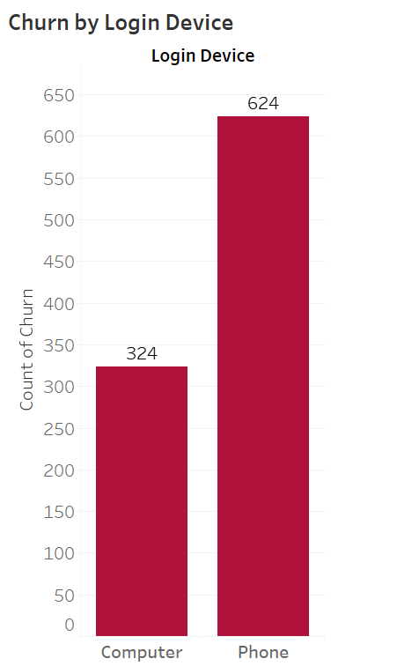
People churn almost two times more using their mobile phones compared to computers. It might be because of instant and temporary emotional decisions. In order to reduce the churn rate, cancelling the membership should be restricted while using cellphones. To do so, only computer login ought to be available option.

Slide 9
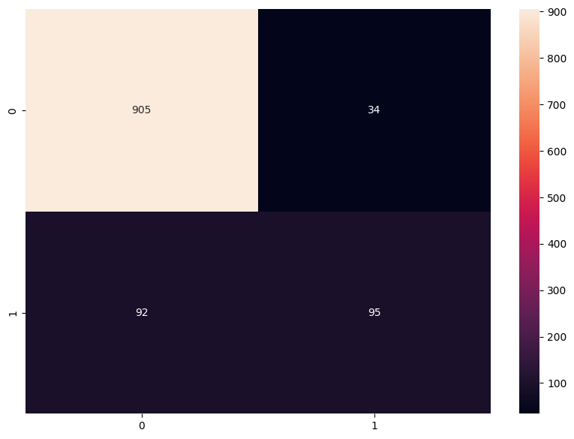
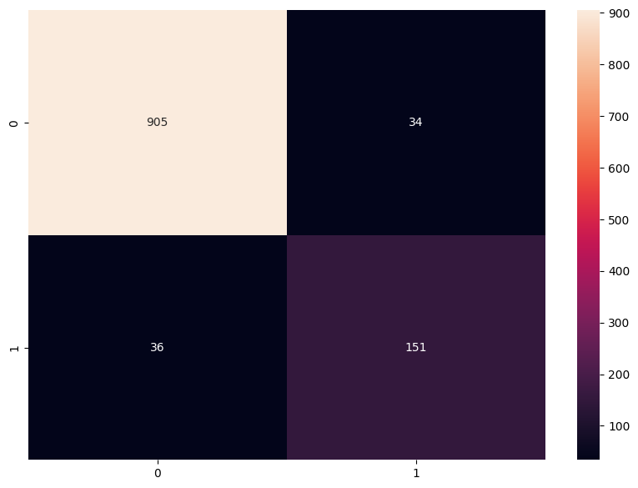
Decision Tree
Test Data Accuracy :0.9378
Logistic Regression
Test Data Accuracy : 0.8881

Slide 10
Groups Likely To Churn
Urban and Developing Area Customers: These regions exhibit higher churn compared to big cities.
Mobile Phone Users: Customers using mobile devices are almost twice as likely to churn compared to those using computers.
Phone Market Customers: The phone market shows high churn despite its prominence, indicating a need for service or experience enhancements.

Slide 11
Recommendations
Focus on Retention within the First Two Months:
Implement proactive engagement strategies to keep customers beyond the critical early phase of the subscription;
Schedule proactive check-ins with customers to gather feedback and address concerns before they decide to leave.
Targeted Engagement for Urban and Developing Area Customers:
Develop marketing strategies that resonate with the unique preferences and challenges of customers in these regions;
Collaborate with local businesses to create offers that are appropriate to this demographic.

Slide 12
Recommendations
Improve the Phone Market Experience:
Create targeted promotions for existing mobile phone customers, such as discounts on accessories, trade-in deals, or upgrade offers.
Encourage Computer-Based Cancellations:
To reduce impulsive churn, it is recommended to restrict cancellation actions on mobile devices and require customers to use computers for account closures.

